Slide 1
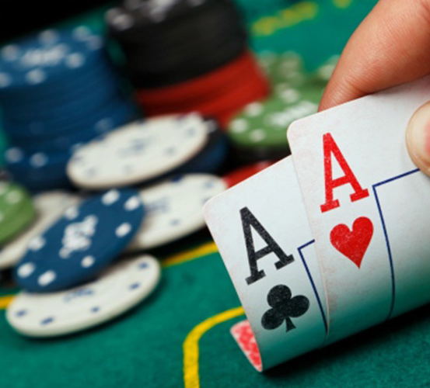
BLACKJACKCHAIN
A blockchain application to the game of blackjack
Bellucci Emanuele - 3088387
Bricarelli Paolo - 3000751
Bruno Luca - 3002713
Nuti Silvia -1831031
Roscioli Dimitri - 3001293
Final project
Finance with big data - 2019/2020

Slide 2
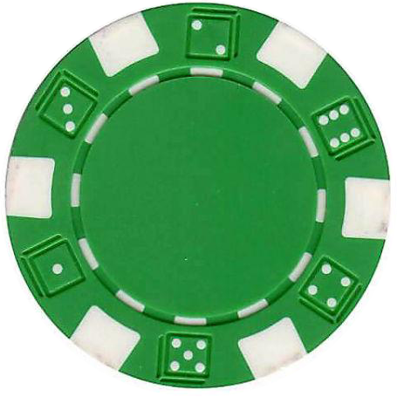
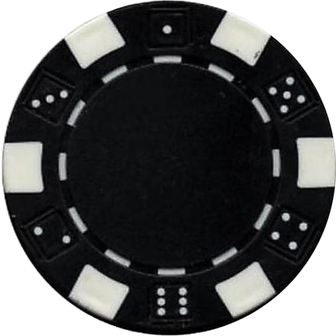
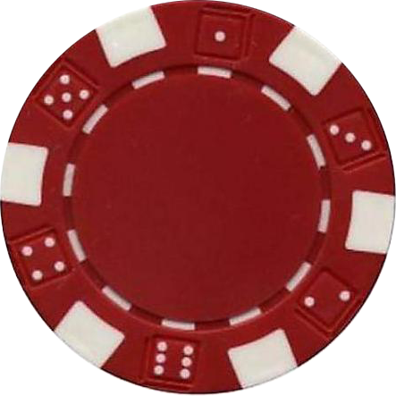
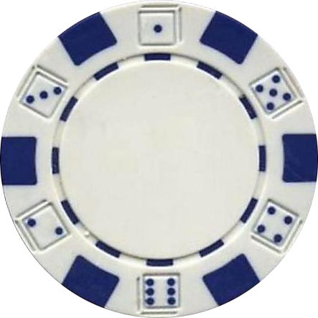
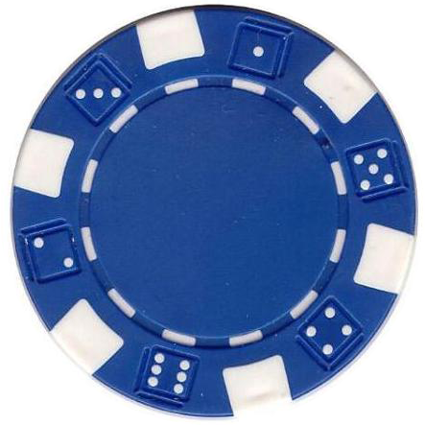
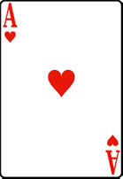
Table of Contents
A brief introduction to our idea and its business implications
Business idea
A Blockchain application
The reasons why the Blockchain system can be applied in this field
The statements under which our project works
Our assumptions
How does it work?
An outline of the various phases of the game under the smart contract
Two simple examples in a “real” setting
Simulation I & II

Slide 3
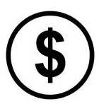
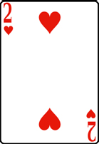
Business idea
The technological innovation has allowed for the creation of online casinos, which are widely used, and the market has reached a value of 55.2 billions of dollars in 2019 (and it is expected to furtherly grow in 2020!).
However, despite the great impact on the economy, they are not rising in number.
The reasons behind this is very simple, there is a HUGE LACK OF TRUST:
players have no idea about the house edge of a gambling game set by a casino;
players do not know who they have on the other side of the table (could be a normal player, a bot or a hacker that can discover their cards);
the casino can use some hidden software that can learn when you’ll bet heavily on a hand/spin/bet and uses this information to earn more money from the players..
This leaves great room for the application of a Blockchain system

Slide 4
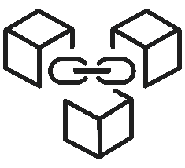

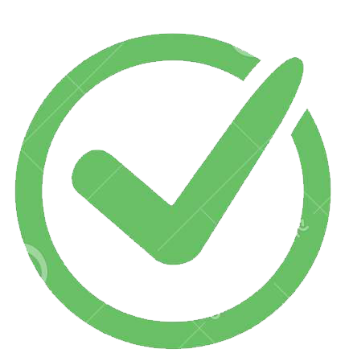
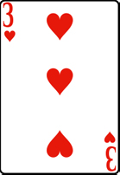
Blockchain application
In this framework, applying the Blockchain would radically change the situation, solving the most pending issues; however, it also has some disadvantages.
transparency of the algorithm used to distribute cards;
transactions involving ETH will be executed immediately (traditional online casinos transfer the money you won from your wallet to your bank account in 2-3 days).
Player has to wait for the blocks to be mined to have new cards or to let the croupier have a new card;
Player cannot place a bet that is higher than the average block reward to avoid that a player with a huge computing power mines a valid block and sees the cards in advance.

Slide 5
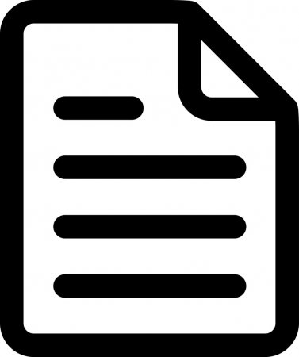

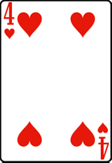
Assumptions
Within the scope of this work a first application of the blockchain system will be done on the game of Blackjack, one of the most widely played. It involves a relationship with the casino (through the dealer), and it is simple enough to allow for its determination through a contract. However, we still need assumptions:
bet amount: the player can place a bet but, as we already said, it must be less than the average block reward;
single player only: the game involves you against the dealer;
no insurance: the player cannot place an insurance on his/her hand;
no double split: the player cannot split his/her hand in case it has 2 or more identical cards;
payoff for blackjack: in case the player hits Blackjack (which, normally, means he/she has an ace and J, Q or K, but here also the combination 10 + ace is considered blackjack), it will be paid 3:2;

Slide 6



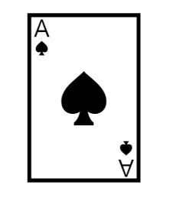


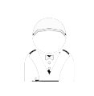
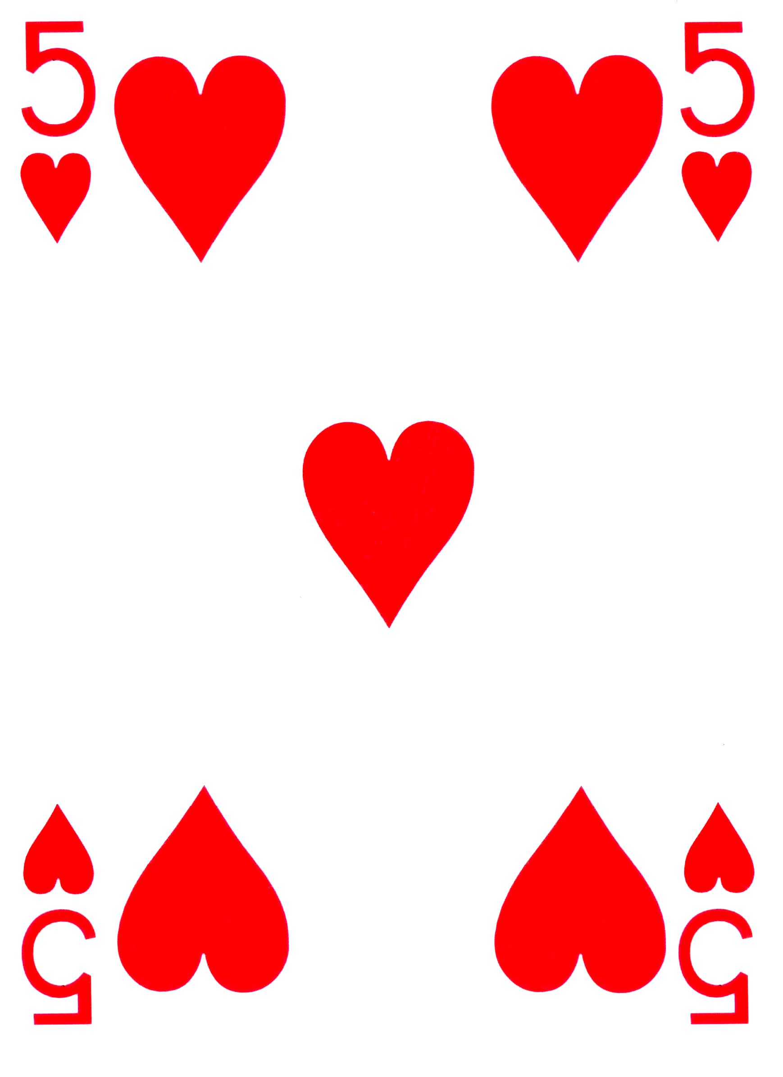
How does it work?
The bet
Before the game starts the player has to place his/her bet; this money will be lost if the player looses or won back in case of victory.
Gamer’s turn
The player, after looking at the cards, has to decide whether to stand or to ask for another (or more) cards. His/her aim is to reach (or go closest to) 21. Mind that if the score goes beyond this threshold the player has lost and the match ends (with the victory of the dealer).
Start
The game begins.
First cards
At the beginning to the player two cards are given, while the dealer keeps only one for himself.
Who wins?
Dealer’s turn
The scores of the gamer and the dealer are compared: the highest one wins.
After the gamer has played, the dealer must decide what to do: after looking at its card he has to decide whether to stand or ask for one (or more) cards to reach at most 21. Exactly as the player, if the score goes beyond that the dealer looses.
End
If the player wins he/she takes twice (or more) of his/her initial bet; on the contrary, if the dealer wins, the gamer looses everything he/she had bet. Everything is set back to 0 and a new match can start.

Slide 7

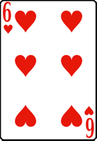
How does the Dealer play?
The Dealer’s strategy starts here!
Does the Dealer have an ace?
yes
no
Is the Dealer’s score between 7 and 11?
The Dealer has 17 points or more?
yes
no
yes
no
Augment Dealer’s hand score by 10 (to allow for comparison with Gamer’s one)
The Dealer has 17 points or more?
Is the Dealer’s score higher than the one of the Gamer?
The Dealer turns another card
no
yes
yes
no
The Dealer turns another card
The Dealer
stands
The Dealer turns another card
Is the Dealer’s score higher than the one of the Gamer?
Is the Dealer’s score higher than the one of the Gamer?
yes
no
Based on the answers to these questions the Dealer either stands or turns a card
The Dealer stands
The Dealer turns another card
yes
no
The Dealer stands
The Dealer turns another card
Reduce back Dealer’s hand score by 10 (so that the procedure can restart correctly)

Slide 8
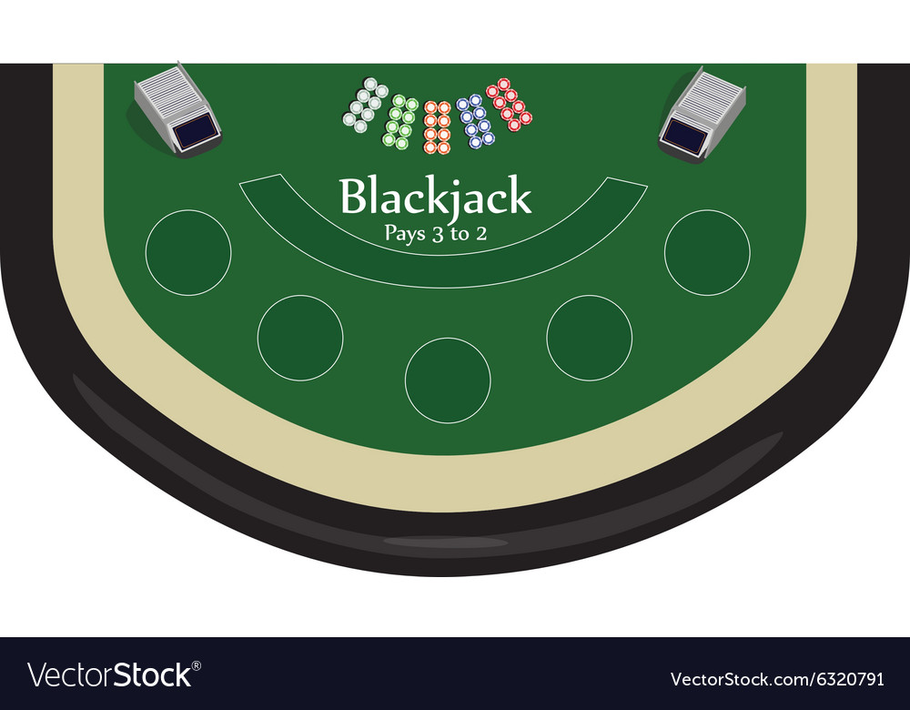
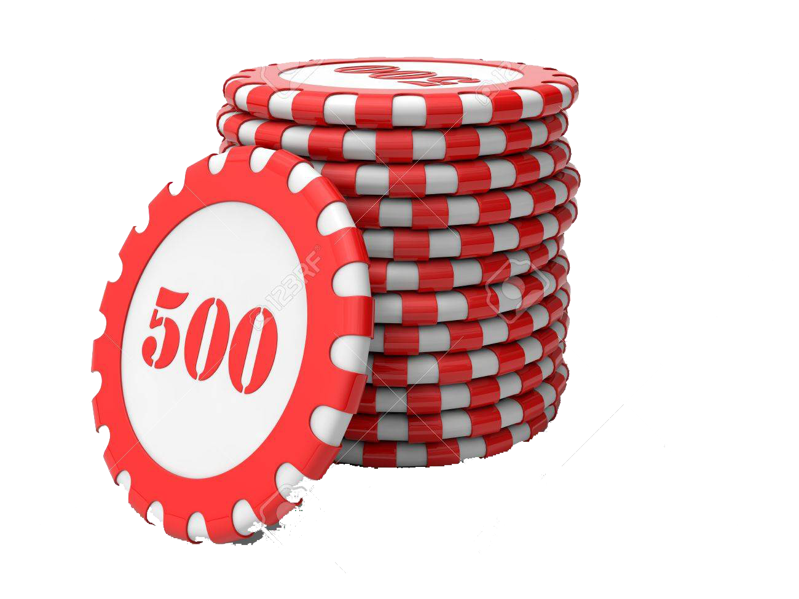
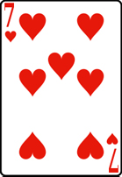
Simulation I
The Gamer places the bet, and the smart contract is set! The game can begin!

Slide 9
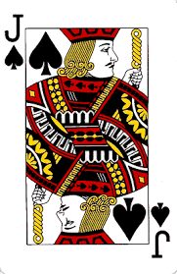
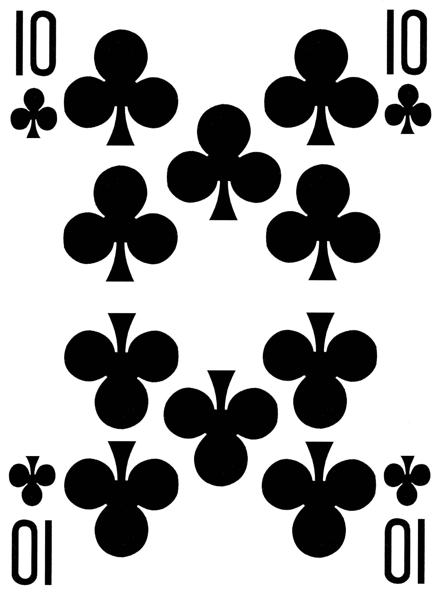
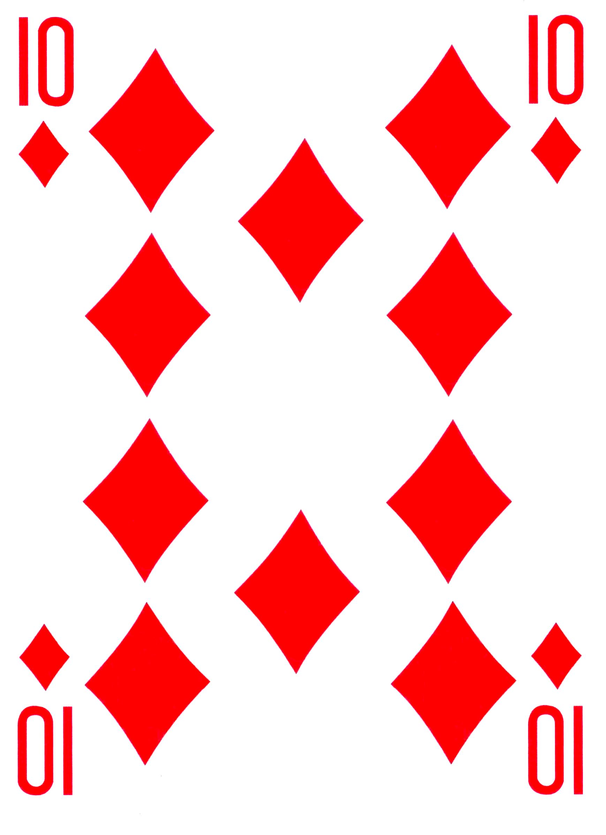
Simulation I
The Dealer gives out the cards

Slide 10
Simulation I
The Dealer instead has a face card, therefore worth 10. He must turn at least another card to reach 17, to follow the rule, and to reach at least 20 to beat the Gamer
The Gamer has a score of 20, which is pretty high; hence he stands

Slide 11
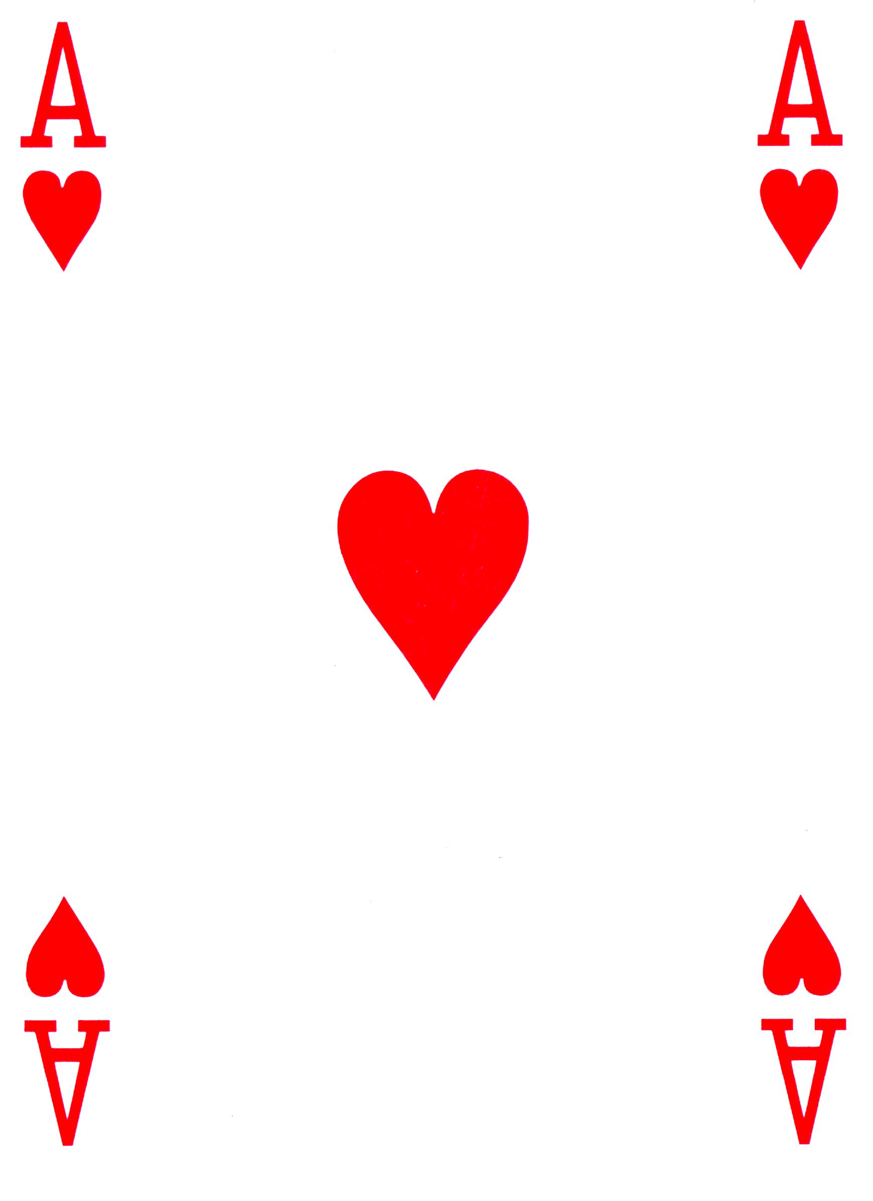
Simulation I
The Dealer has turned an ace and has therefore a Blackjack!

Slide 12
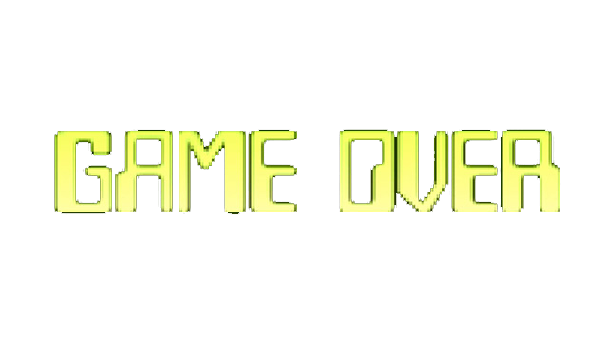
Simulation I
The winner is the Dealer and therefore takes the bet

Slide 13
Simulation I
The game is terminated, everything is reset and another game can begin

Slide 14
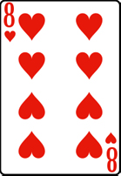
Simulation II
As always, the game cannot begin without the Gamer’s bet

Slide 15
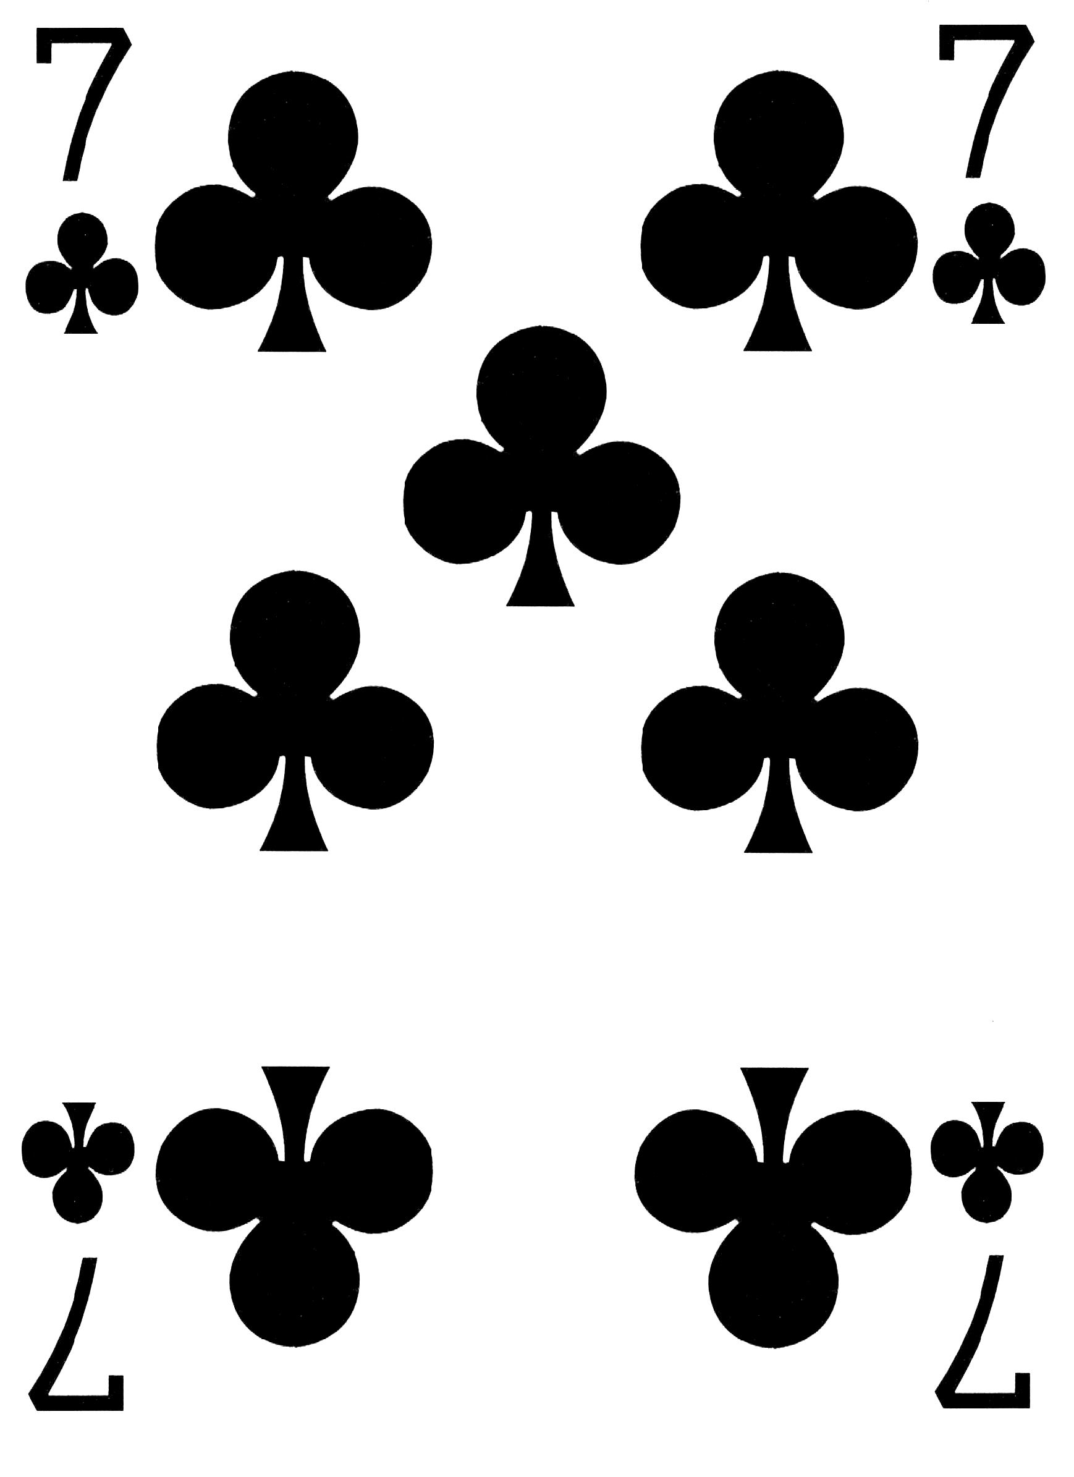
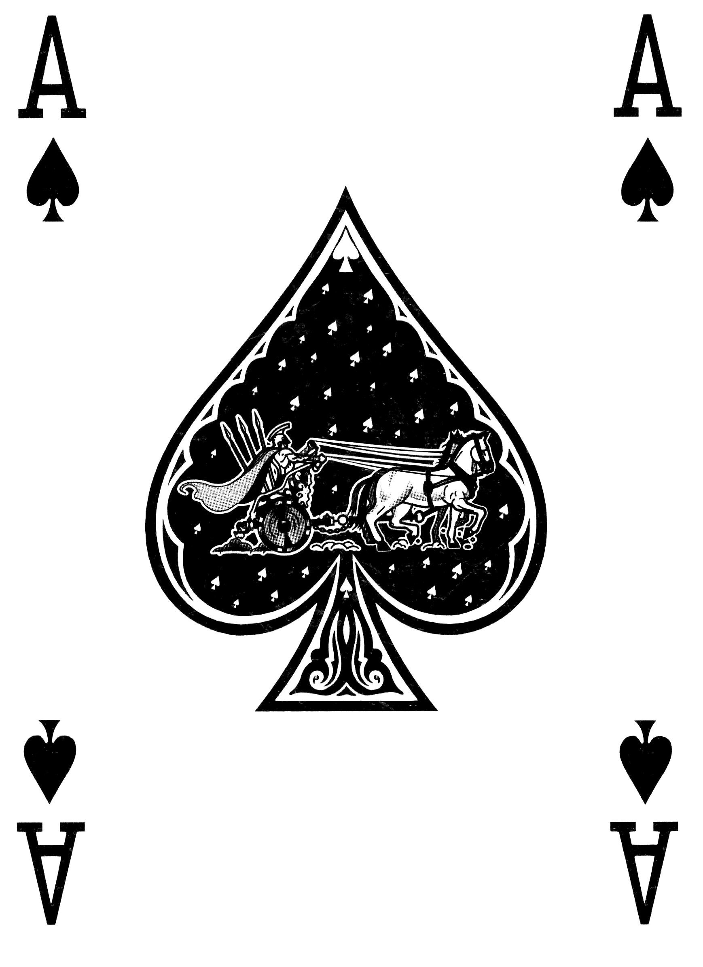
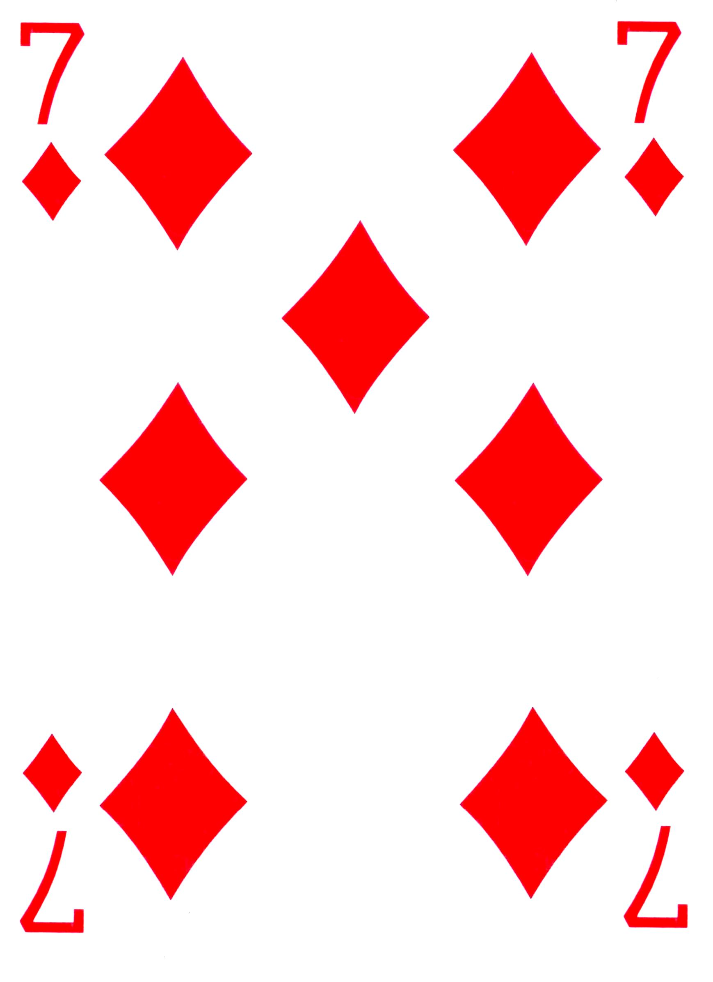
Simulation II
The Dealer distributes the cards

Slide 16
Simulation II
The Gamer has an ace, which can be worth 1 or 11. For this the Gamer decides to risk it and asks for another card

Slide 17
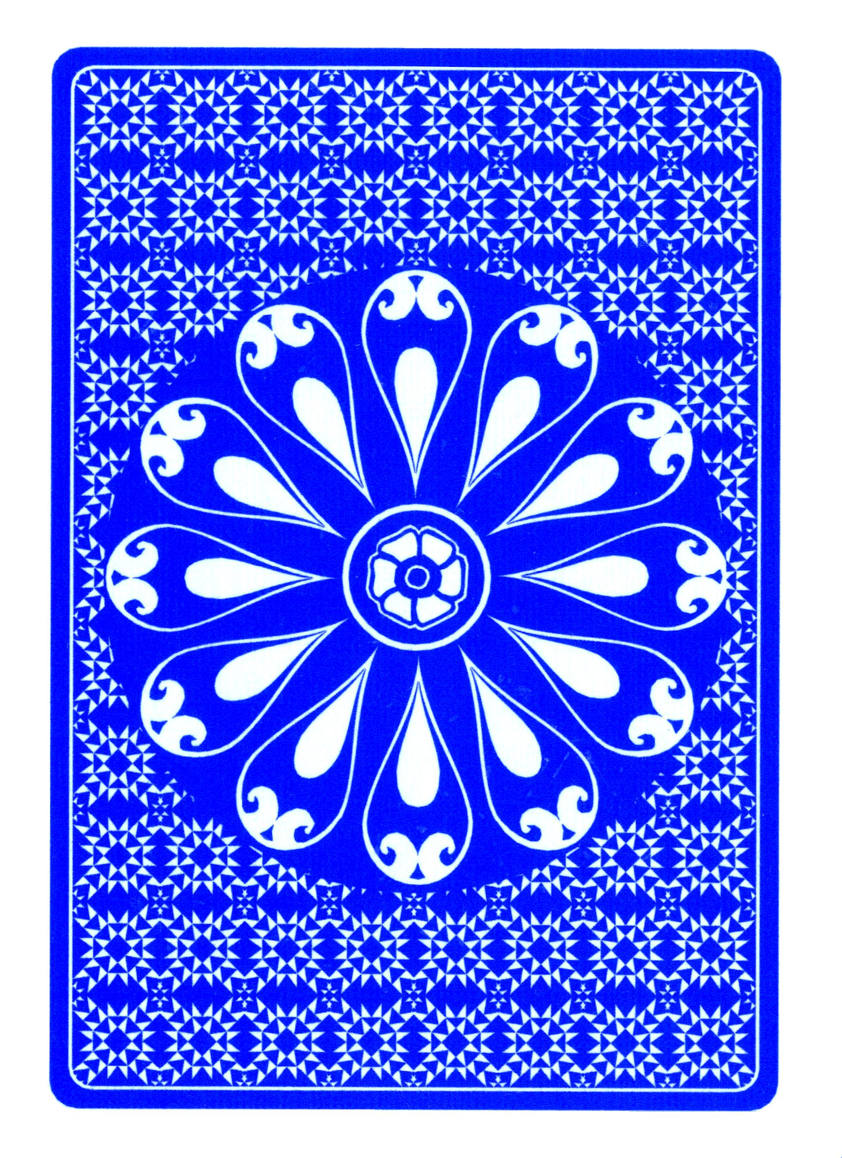
Simulation II
The Dealer has only 7 as a score; according to the 17 rule, he must turn another card!
The Gamer receives the card, looks at it and decides to stay, passing the hand to the Dealer

Slide 18
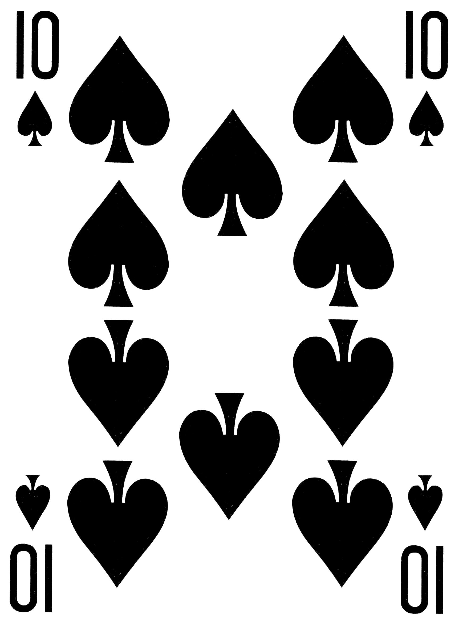
Simulation II
The Dealer has 17, so the rule is satisfied. However, the Gamer has between 18 and 21 (otherwise he would have busted and he would have had to diclare that); hence the Dealer, to win, must turn another card

Slide 19
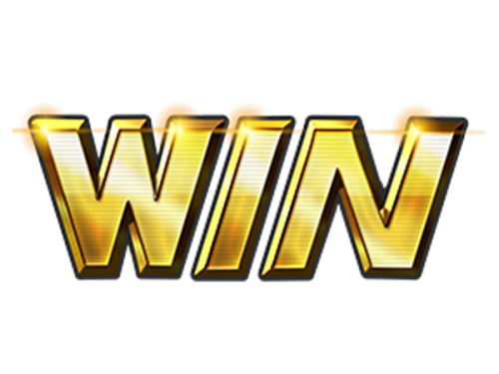
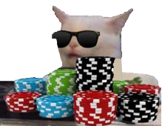
Simulation II
The Dealer has scored beyond 21, so he busted!
The winner is the Gamer, and he takes the bet!

Slide 20

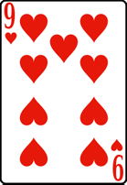
References
www.statista.com
J. Cotte, K. A. Latour (2009). “Blackjack in the Kitchen: Understanding Online versus Casino Gambling”, Journal of Consumer Research, Volume 35, Issue 5
S. M. Gainsbury, N. Hing, P. H. Delfabbro, D. L. King (2013). “A taxonomy of gambling and casino games via social media and online technologies”, Journal of International Gambling Studies, Volume 14, Issue 2.
S.M. Gainsbury, A. Blaszczynski (2017). How Blockchain and cryptocurrency technology could revolutionize online gambling, Gaming Law Review, Volume 21, No. 7

